Slide 1
Strange grading methods of Professor Moody
Zhaohan Yan 172008944

Slide 2
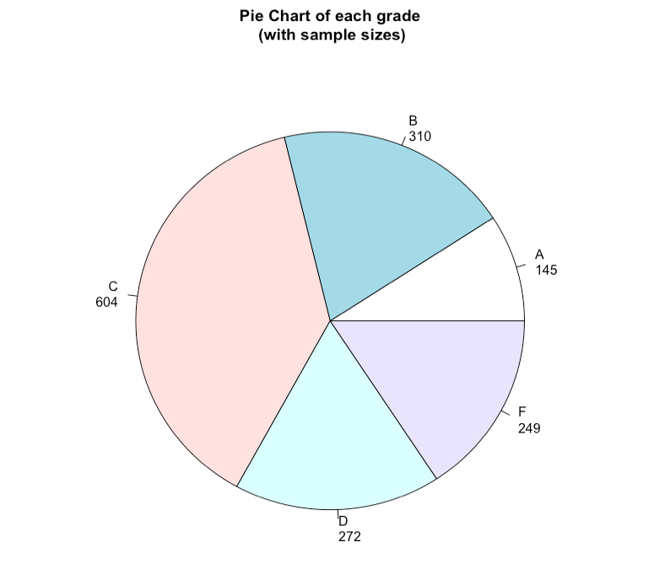
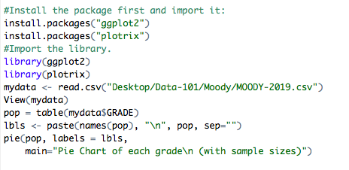
Back Ground
Professor Moody kept track of what students do, counting number of questions, detecting smartphone use during the class and remembering exactly who was late to class and who left early in order to give grade. Study of the previous year dataset with all the information we are able to give a better advise on what to pay attention in class. Use a pie chart can give us an basic idea of the distribution of different grade. We can see that a large percentage student got grade C.

Slide 3
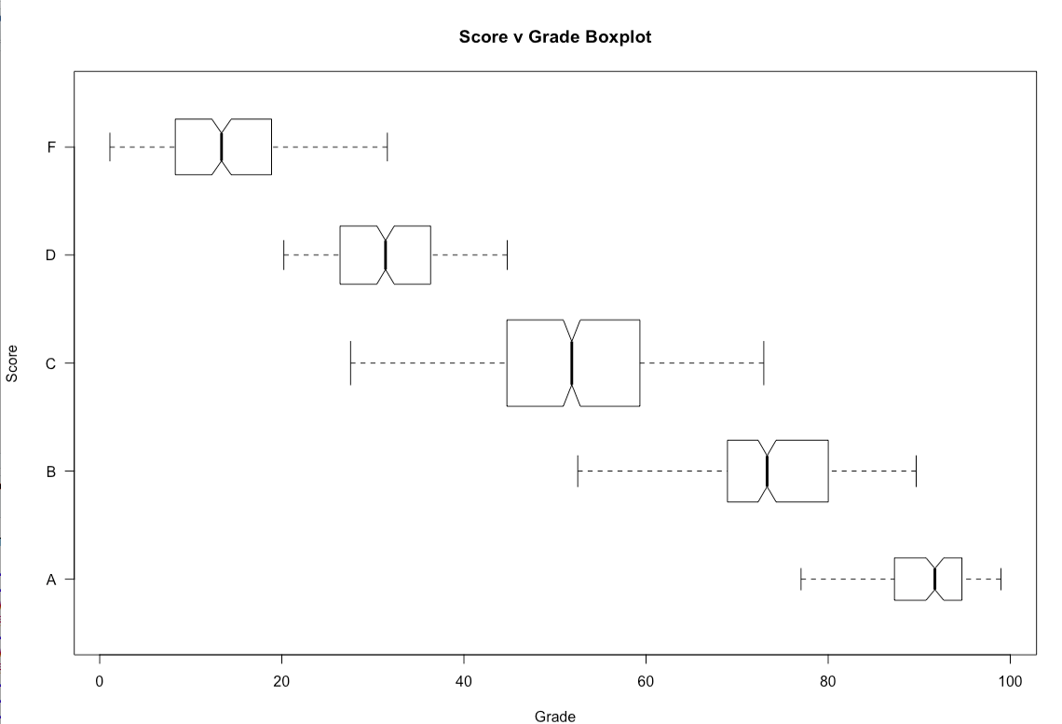
Effects of scores on grade
boxplot(mydata$SCORE~mydata$GRADE,main='Score v Grade Boxplot', ylab = 'Score', xlab = 'Grade',varwidth=TRUE,horizontal = TRUE,las=1,notch=TRUE,outline = FALSE)
This code gives the boxplot regarding students’ scores and grades.
From this plot we can see that even though it seems like the higher letter grade got a higher mean score, however, there are overlapping in terms of scores and grade which means scores contributes to the final letter grade but is not the only factor to consider when determine the letter grade.

Slide 4
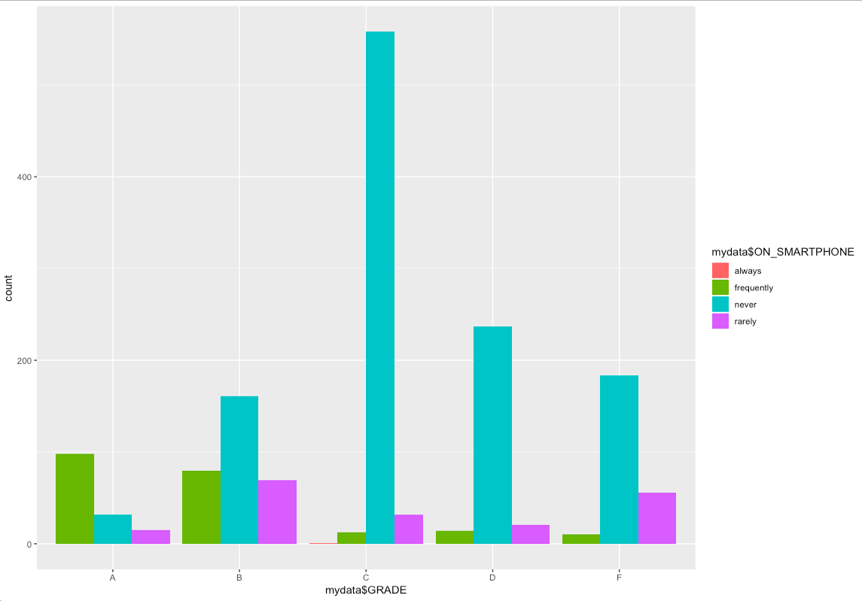
Is use of mobile phone important in Class?
This code help me generate a histogram with numbers of students got different letter grade when separated into group that track how often one use mobile phone in class.
From the graph we found that students frequently using cell phone in class got better grade.(Green box)

Slide 5
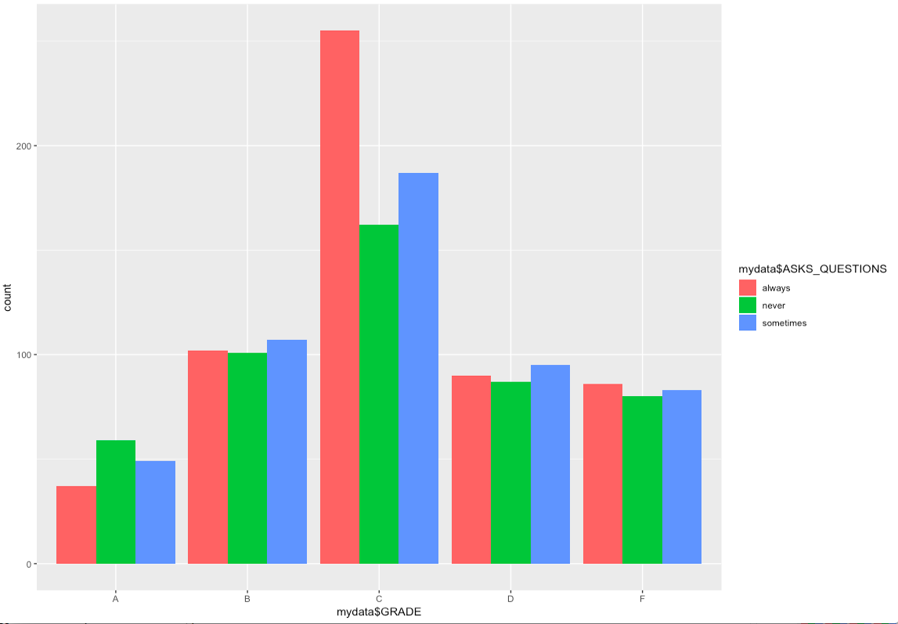
How about participation in class
This is a graph that can help us figure out weather participation help students get a better grade. From the graph we found out, always ask questions in class may not help you get a better grade.

Slide 6
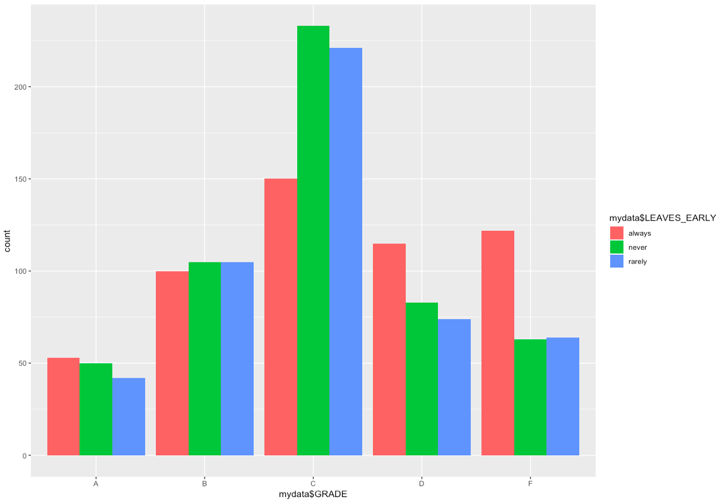
Leave early?
From the graph we can tell always leave early in class will result in higher chance getting an “F”

Slide 7

Late?
From the graph we can see that Late to class probably have less effects on the final grade.

Slide 8
In Conclution
Plot can help us generate a basic idea of weather each factors have effects on the final grade, however, to know exactly how each factor contributes to what percentage of the final grade we still need to do further analysis.
From what we got so far we can make some hypothesis that:
Even high score may not assure you to get a higher point, but people who got higher grade have a high possibility of getting high score. Advise: Score as priority.
Professor Moody probably encourage cell phone use in class(Probably use to track attendees or class activities)

